Slide 1
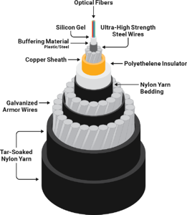
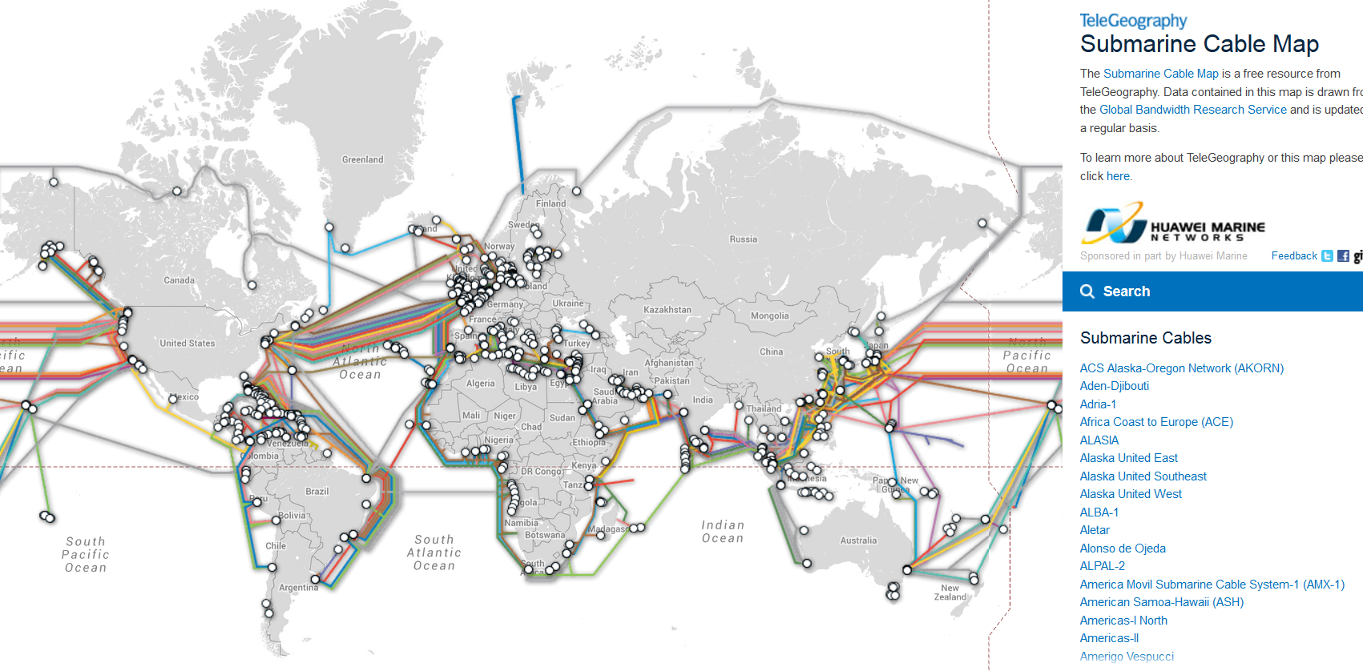

406 Submarine Cables
Minimum design life of 25 years.
Satellites account for 0.37% of all U.S. international capacity.
The new MAREA cable is capable of carrying 208 Tbps.
Google, Facebook, Microsoft, and Amazon are major investors in new cable.
Total 1.2 million km (2020)

Slide 2
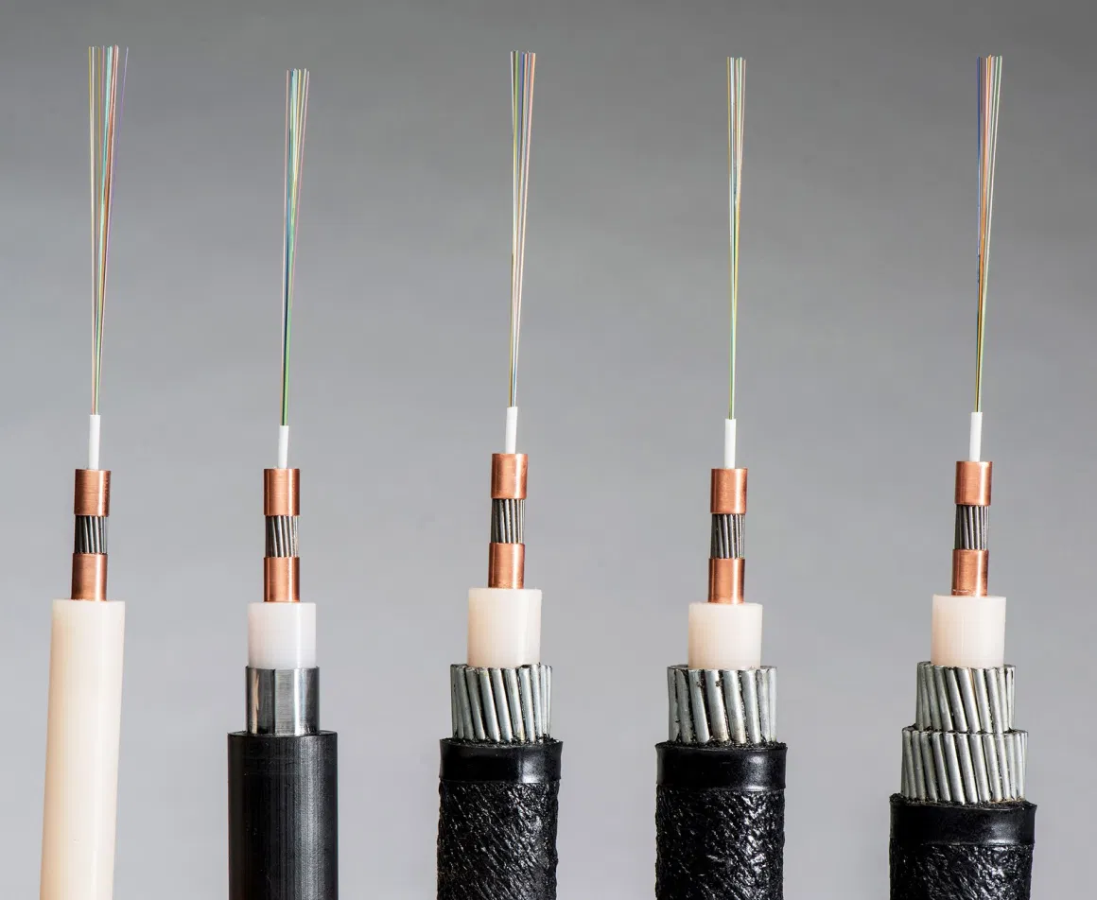
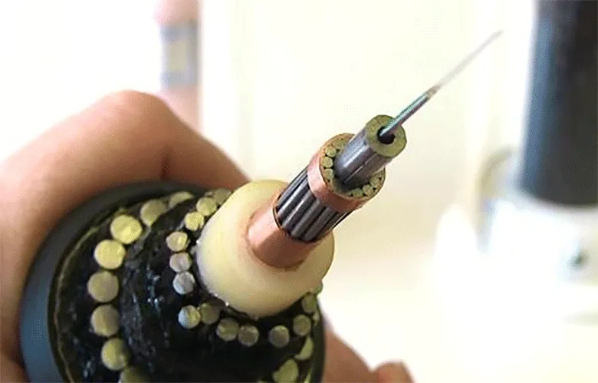
Manufacturing & Deployment
Japanese NEC developed 20 fiber pair (40) cable. (2020)
Google announced a cable with 24 pairs of optical fibers.
Bandwidth of 12-pair Dunant is declared at 250 Tbps.
DWDM allows 100 wavelengths over a single fiber.
Largest manufacturers:
Alcatel Submarine Networks (ASN) (France)
TE SubCom (USA)
Nippon Electric Company (NEC) (Japan)
Prysmian (Italy)
Nexans (France)
Hengtong (China)
Zhongtian (China)
Lightweight (LW)
> 2000m
Light-Wire Armored (LWA)
Buried
Double Armored (DA)
Beach joint-400m
Special Application (SPA)
900-2000m
Single Armored (SA)
400-900m
Light
Subcom Fiber Optic Cable Kit.

Slide 3
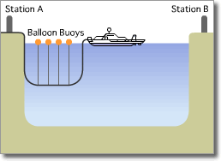
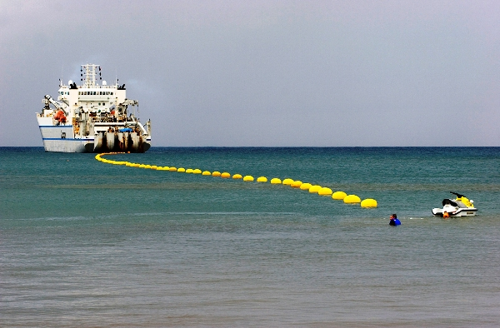
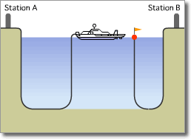
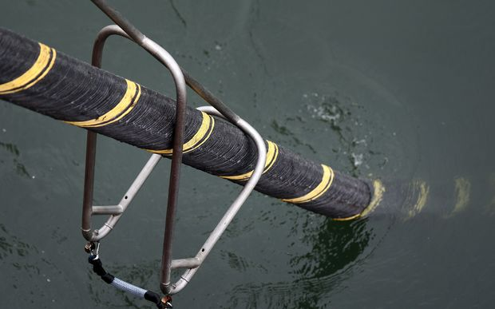
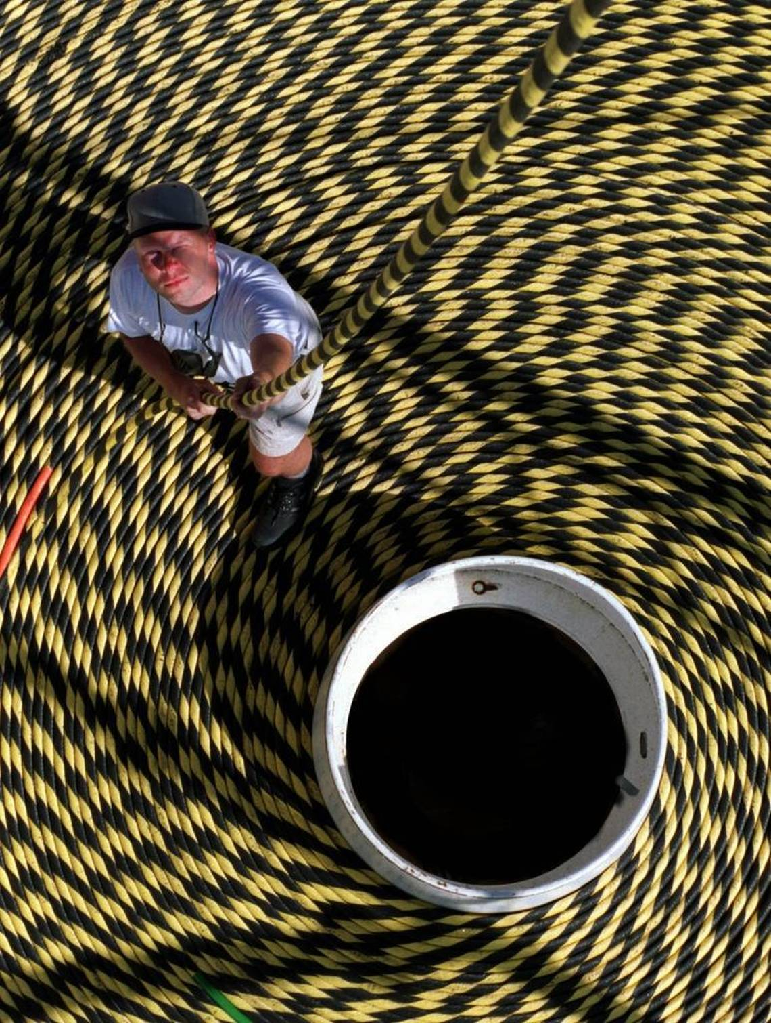
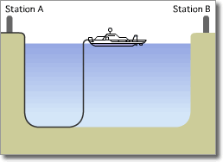
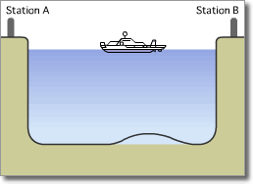
1. Extending
3. Splicing with other side
2. Dropping
4. Dropping

Slide 4
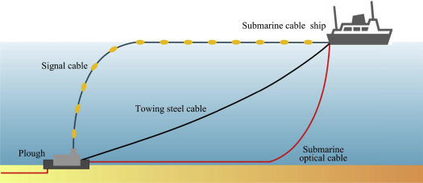
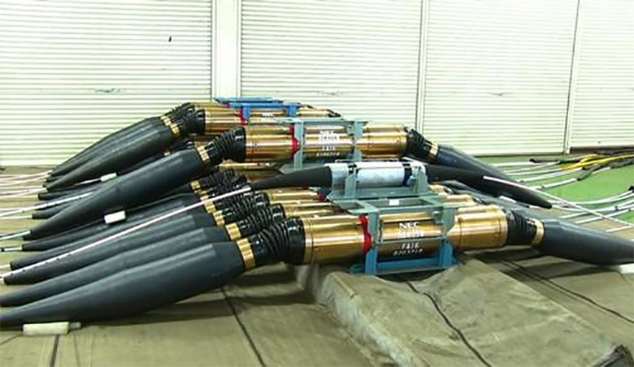
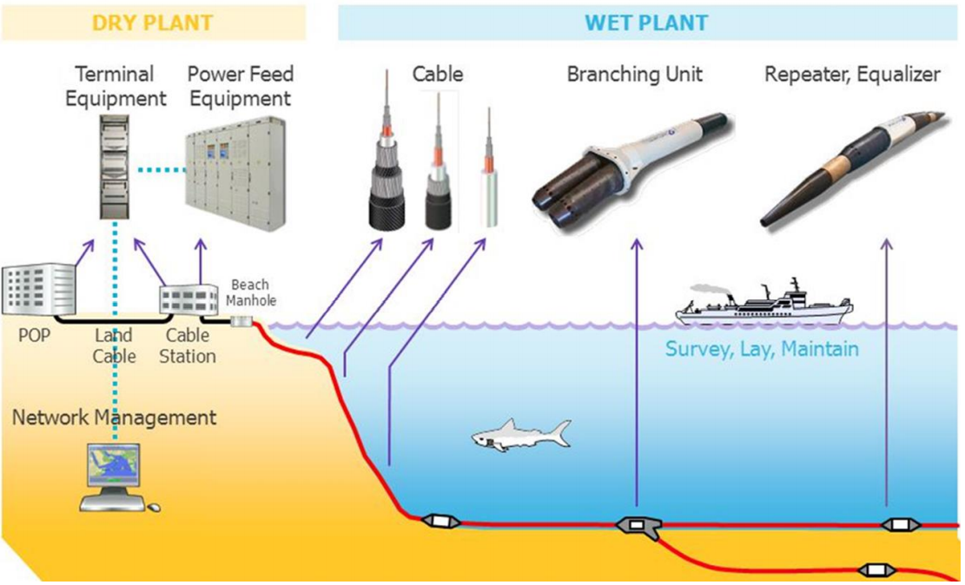
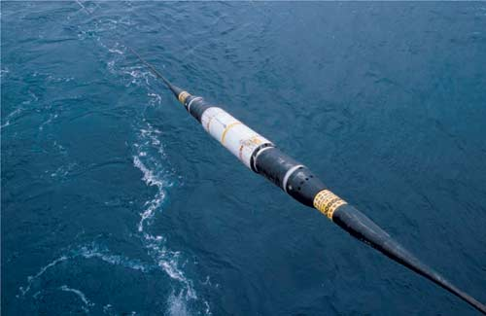
Hydro Jet
Cable laying
NEC repeaters with four signal amplifiers are located at the OCC factory in Japan.
Network architecture
Alcatel Submarine Networks Optical Repeater

Slide 5
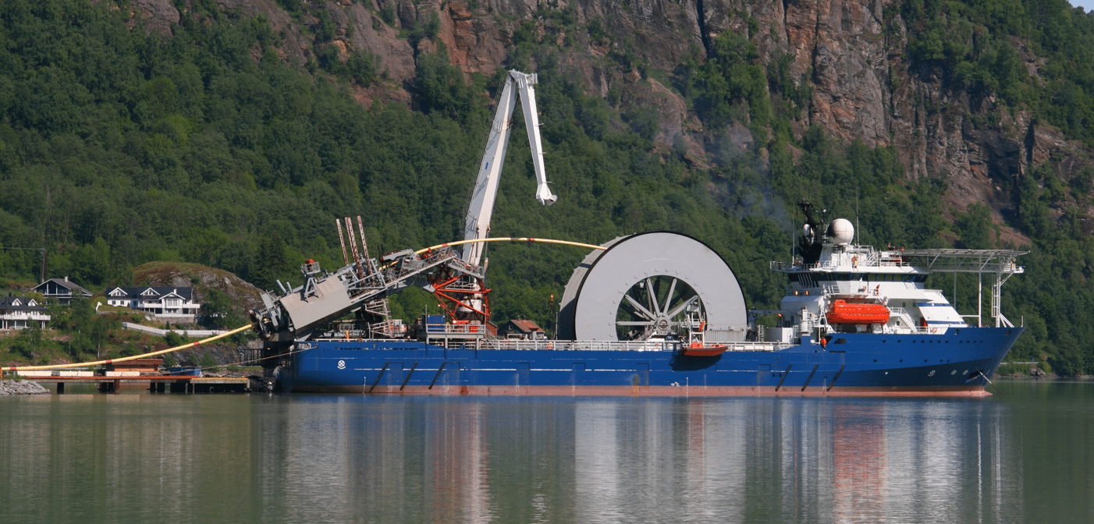
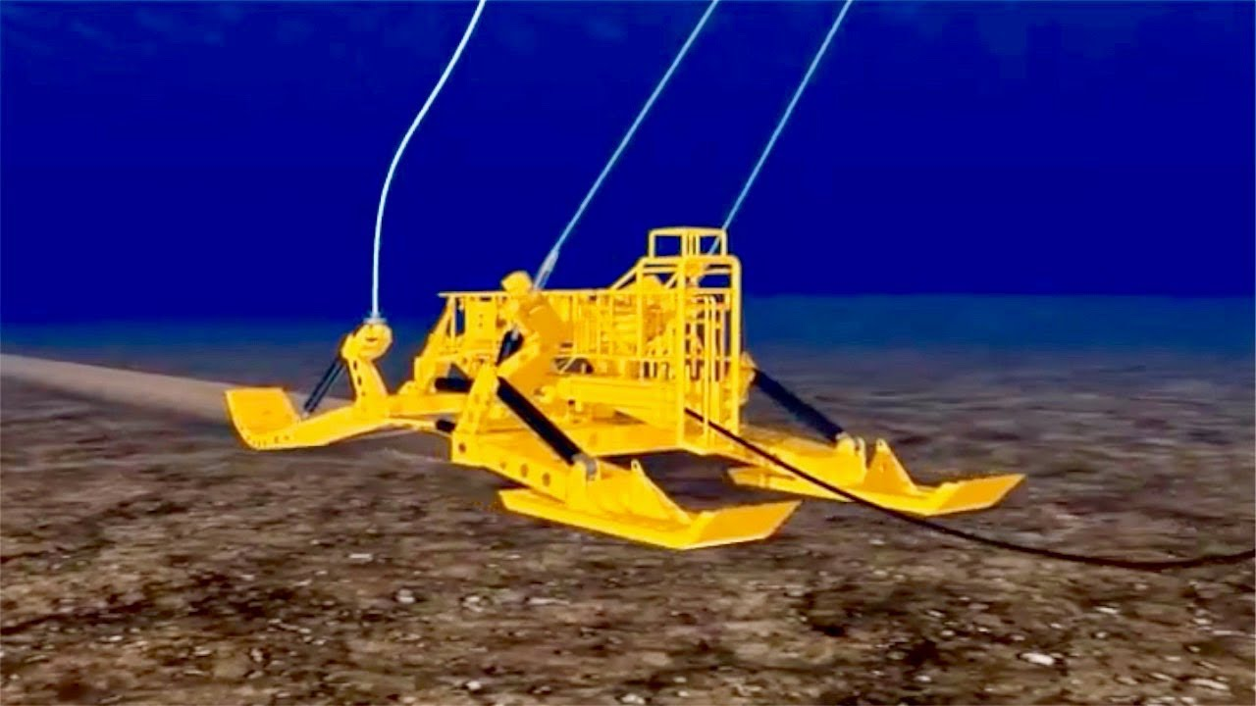
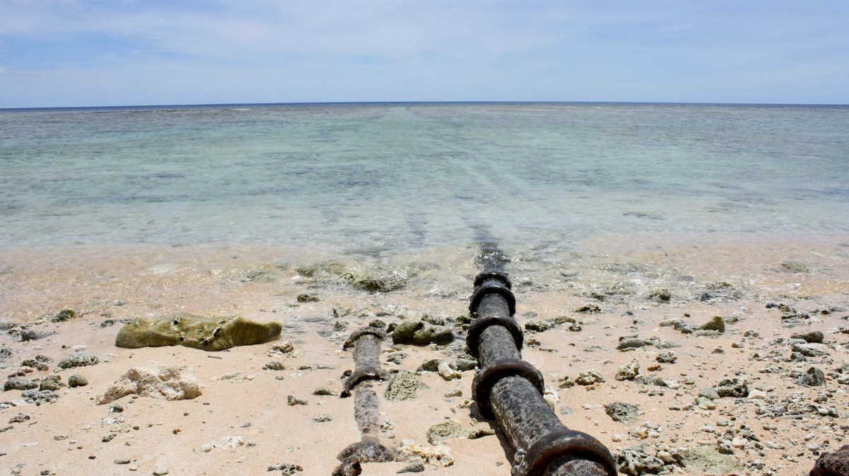
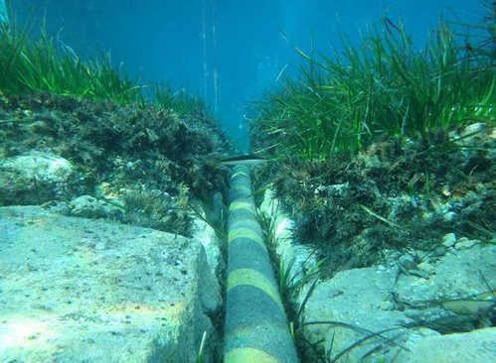
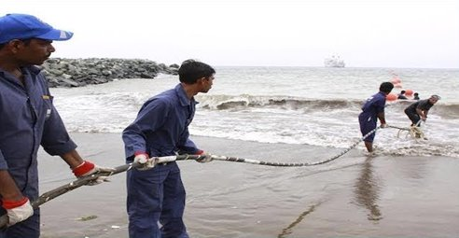
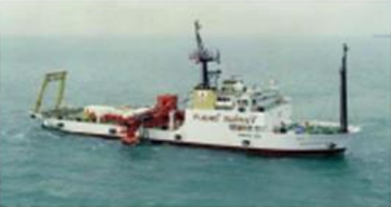
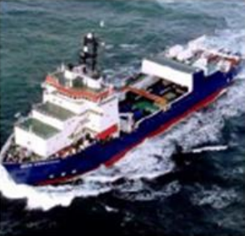
Sea plow for Cable burial
Installation ship
Polynesia submarine cable
Survey ship
Maintenance ship

Slide 6
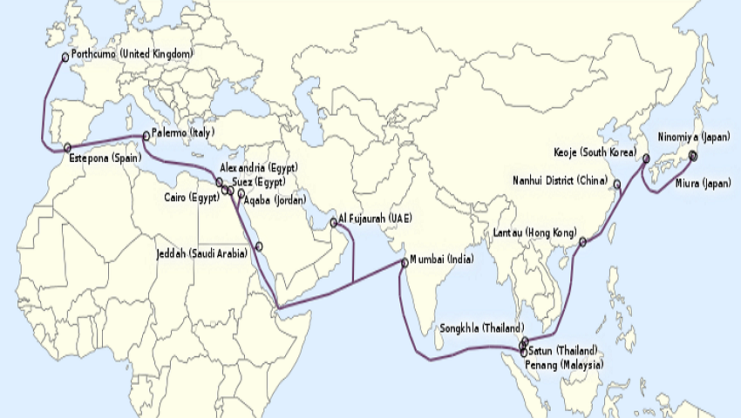
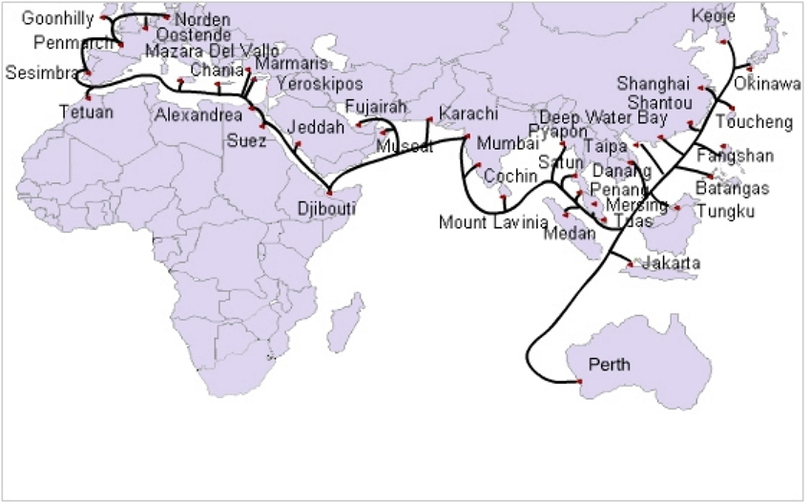
FEA
SEA-ME-WE 3
The FLAG Europe Asia (Fiber-optic Link Around Globe).
Length: 28,000km, Capacity: 80Gbps (1997)
Operators: Global Cloud Xchange (RCOM) (1)
CLS: Chennai (Tata Comm.) (18)
The South-East Asia Middle East Western Europe 3.
Length: 39,000km, Capacity: 100G (1999)
Operators: BSNL (92)
CLS: Mumbai (Tata Comm.), Kochi (Tata Comm.) (39)

Slide 7
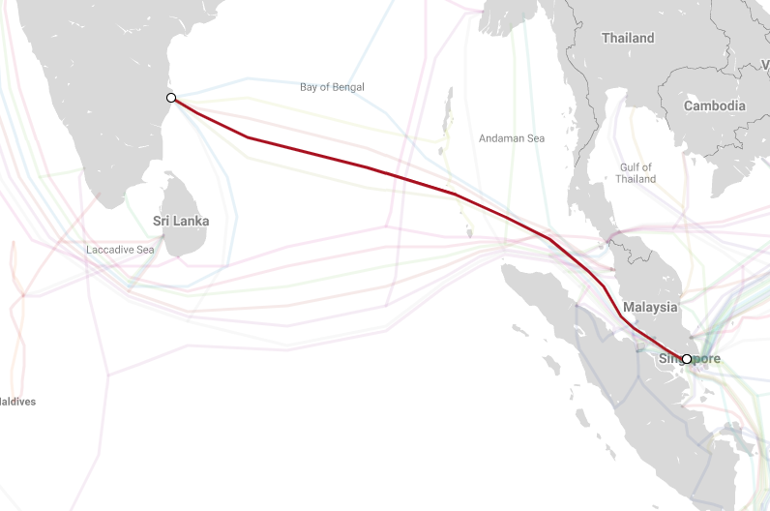
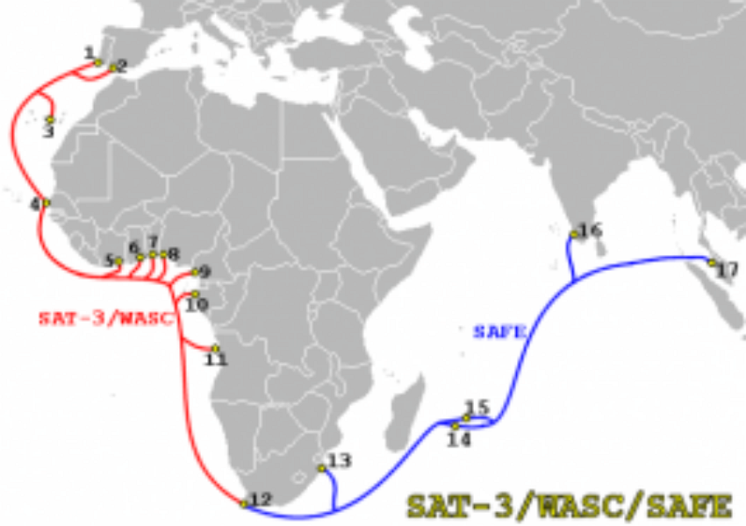
I2ICN
SAFE
The i2 Cable Network.
Length: 3,100km, Capacity: 8.4Tbps (2002)
Operators: Bharti Airtel (2)
CLS: Chennai (Airtel) (2)
The South Africa Far East.
Length: 13,500km, Capacity: 130Gbps (2002)
Operators: Tata Comm. (30)
CLS: Cochin (Tata Comm.) (6)

Slide 8
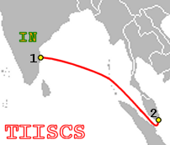
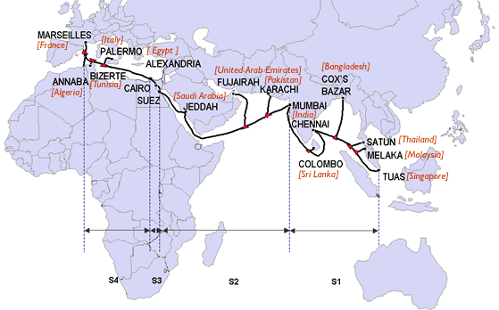
TIC
SEA-ME-WE 4
The Tata Indicom Cable.
Length: 3,175km, Capacity: 5.1Tbps (2004)
Operators: Tata Comm. (1)
CLS: Chennai (Tata Comm.) (2)
The South East Asia-Middle East-West Europe 4.
Length: 18,800km (4), Capacity: 4.6Tbps (2005)
Operators: Tata Comm., Bharti Infotel (16)
CLS: Mumbai (Airtel), Chennai (Airtel) (17)

Slide 9
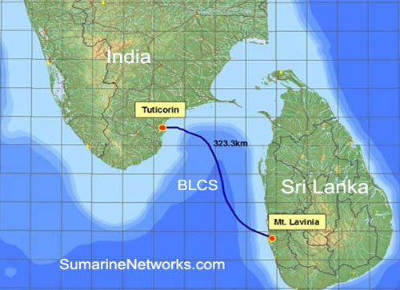
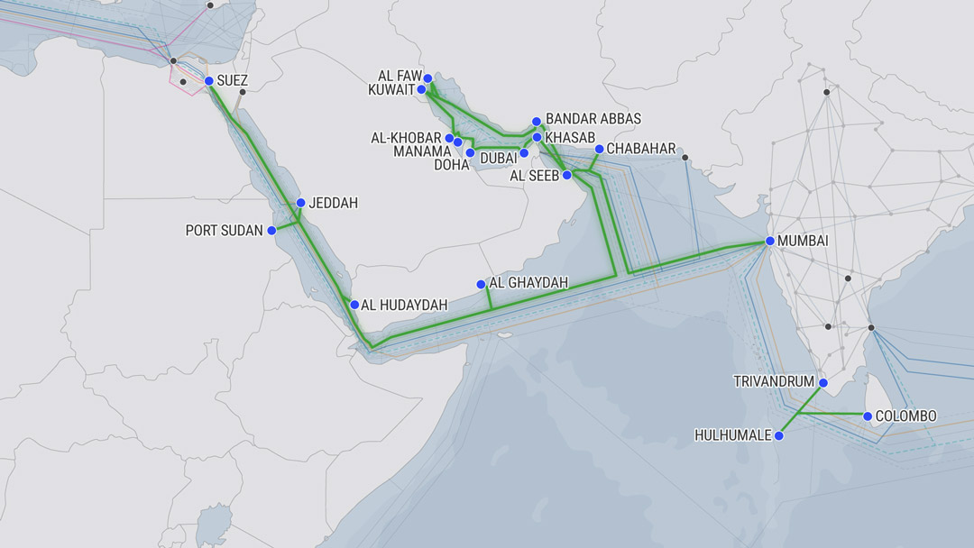
BLCS
FALCON
The Bharat Lanka Cable System.
Length: 320km, Capacity: 1Tbps (2006)
Operators: BSNL (2)
CLS: Tuticorin (Reliance) (2)
The FLAG Alcatel-Lucent Optical Network.
Length: 11,859km, Capacity: 2.56Tbps (2006)
Operators: Global Cloud eXchange (16)
CLS: Mumbai (Reliance) (17)

Slide 10
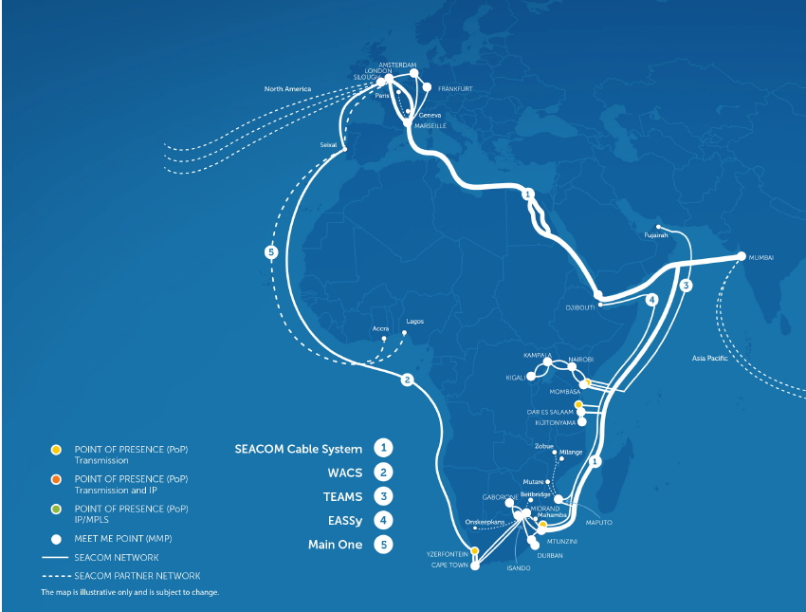
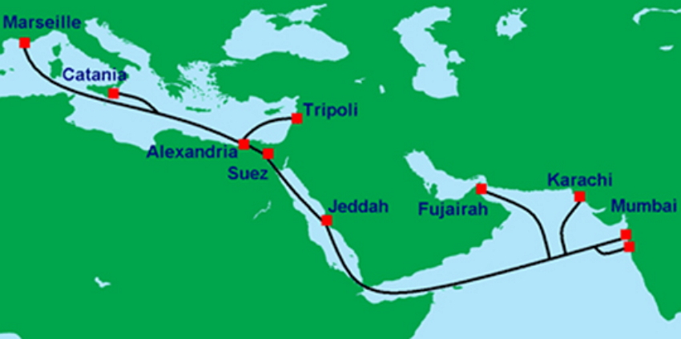
SEACOM
IMEWE
The SEACOM Cable.
Length: 17,000km, Capacity: 1.5Tbps (2009)
Operators: (5)
CLS: Mumbai (Tata Comm. / VSNL) (9)
The India Middle-East Western-Europe.
Length: 12,091km, Capacity: 5.6Tbps (2010)
Operators: Bharti Airtel, Tata Comm. (9)
CLS: Mumbai (Tata Comm.) (10)

Slide 11
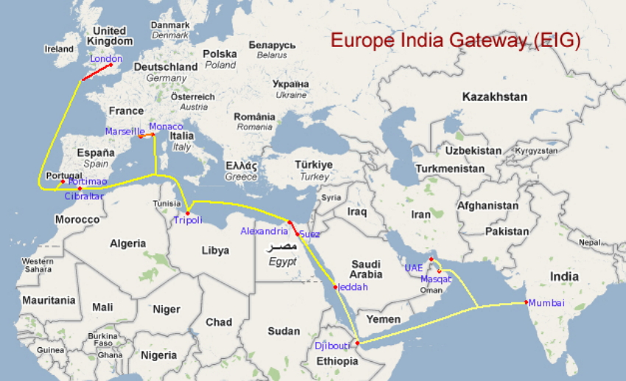
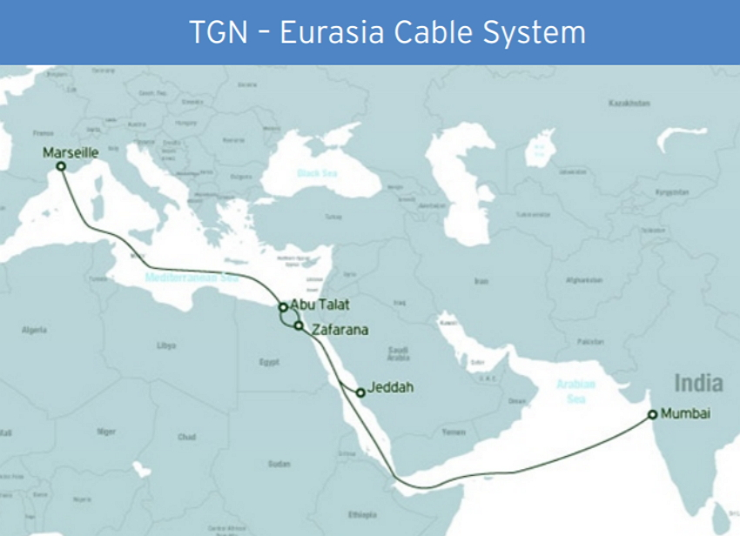
EIG
TGN-EA
The Europe India Gateway.
Length: 15,000km (4), Capacity: 3.8Tbps (2011)
Operators: Bharti Airtel, BSNL (16)
CLS: Mumbai (Airtel) (12)
The Tata Global Network-Eurasia.
Length: 9,280km, Capacity: 1.28Tbps (2012)
Operators: Tata Comm. (1) (RTD: 92ms)
CLS: Mumbai (Tata Comm. / VSNL) (5)

Slide 12
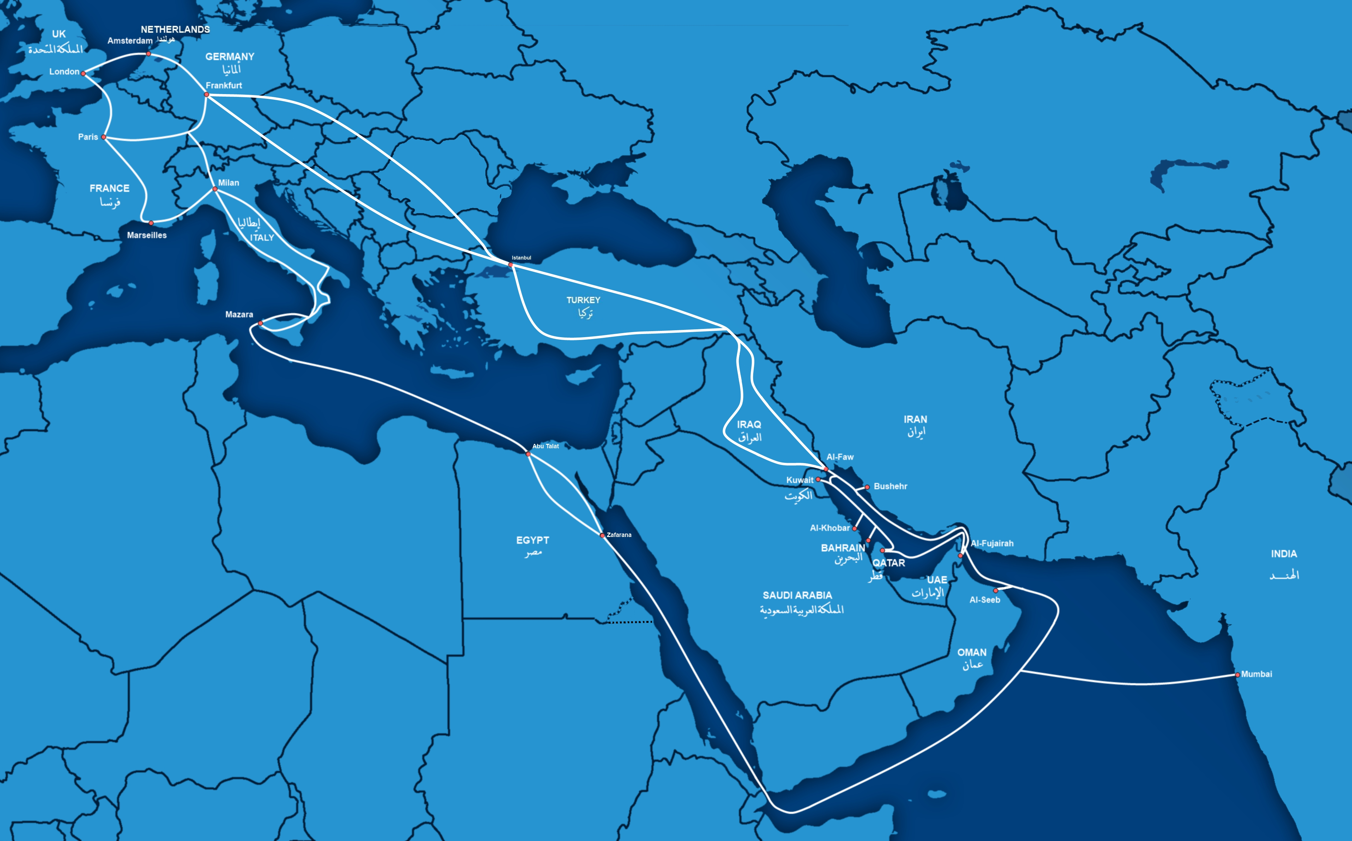
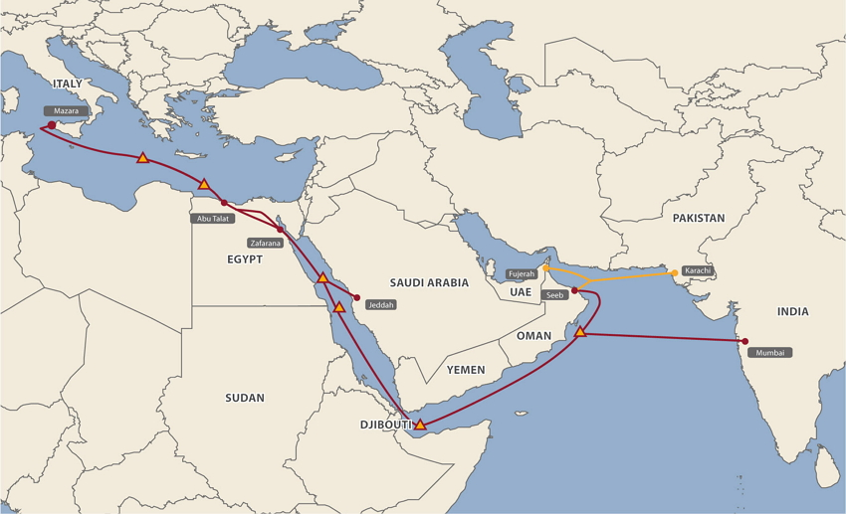
GIBY
MENA
The Gulf Bridge International.
Length: ?km, Capacity: 5.6Tbps (2012)
Operators: Bharti Airtel (?)
CLS: Mumbai (Sify Tech.) (10)
The Middle East North Africa.
Length: 8,800km, Capacity: 5.8Tbps (2014)
Operators: Bharti Airtel (?)
CLS: Mumbai (Sify Tech.) (7)

Slide 13
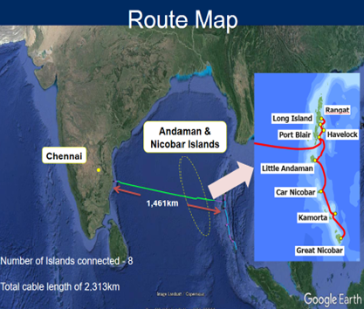
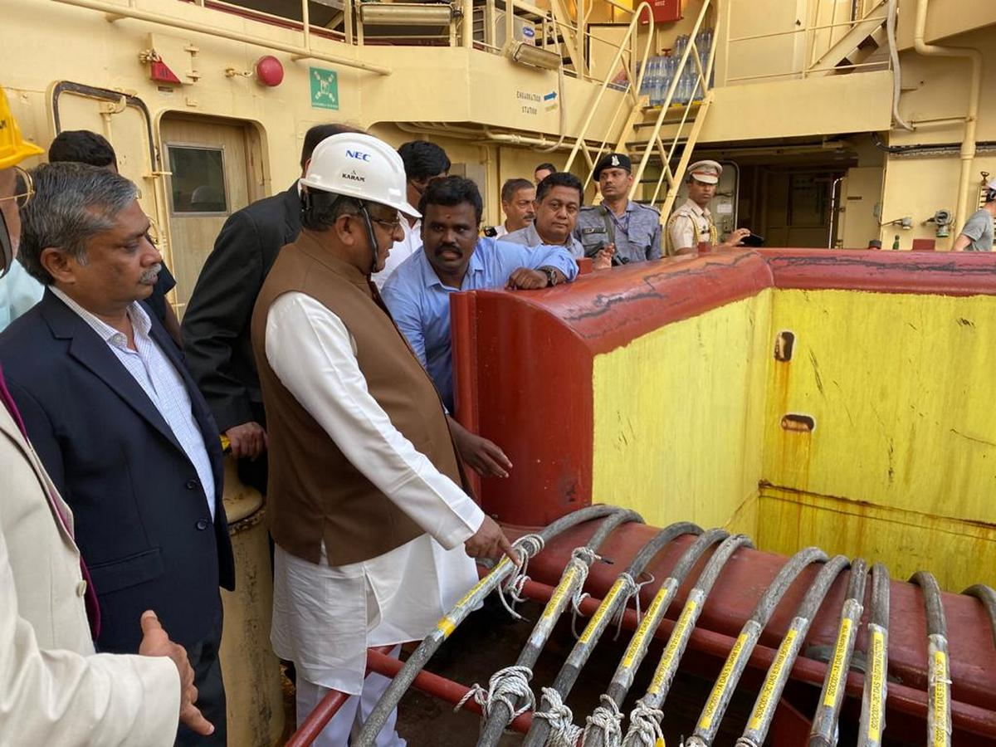
CANI
The Chennai - Andaman and Nicobar Islands.
Length: 2300km, Capacity: 6.4Tbps x 4 (Aug 2020)
Operators: BSNL (?), Cost: 1224 Cr.
CLS: (9), Handled by: NEC Corp. (Japan)

Slide 14
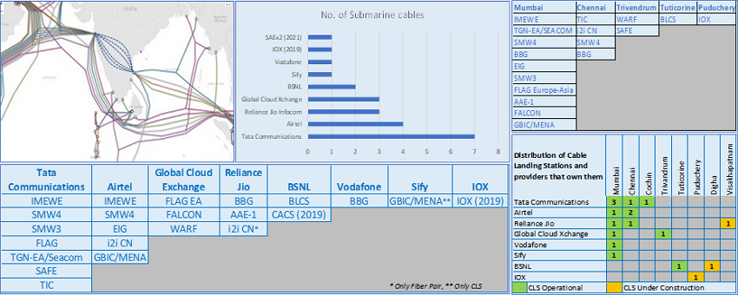
Cable Landing Stations in India
GCX: Reliance Globalcom B.V.
IOX: India Ocean eXchange

Slide 15
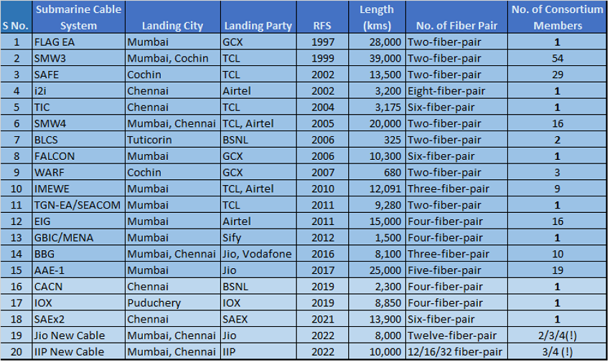

Slide 16
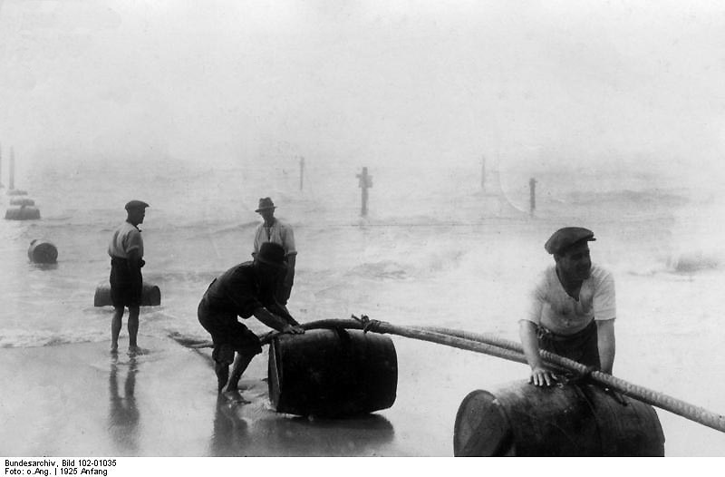
Landing of an Italy-USA cable (4,704 nautical miles long), on the Rockoway beach, New-York, January 1925.

